Slide 1
Three key OLAP capabilities
Must support multi-dimensional analysis
Fast retrieval times
Calculation engine that can handle specialized multi-dimensional math

Slide 2
OLAP: Dimensions (highest level)
Lists of related items (products, time regions)
Dimensions combined into cubes
Ability to slice and dice
Get a different perspective
Product performance over time
Region performance over time

Slide 3
Multidimensional Operations
Roll-up
Drill-down
Slice and Dice:
Look at data from different viewpoints.
Slice performs a selection on one dimension of the data.
e.g., sales revenue (type = ‘Flat’).
Dice uses two or more dimensions.
e.g., sales revenue (type = ‘Flat’ and time = ‘Q1’).
Pivot:
Rotate the data to provide an alternative view of the same data.
e.g. sales revenue data displayed using the location (city) as x-axis against time (quarter) as the y-axis can be rotated so that time (quarter) is the x-axis against location (city) is the y-axis.

Slide 4
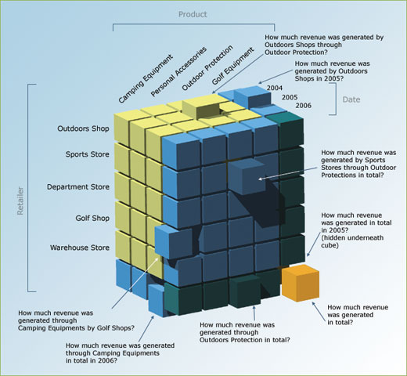
OLAP Cube to Answer Daily Questions

Slide 5
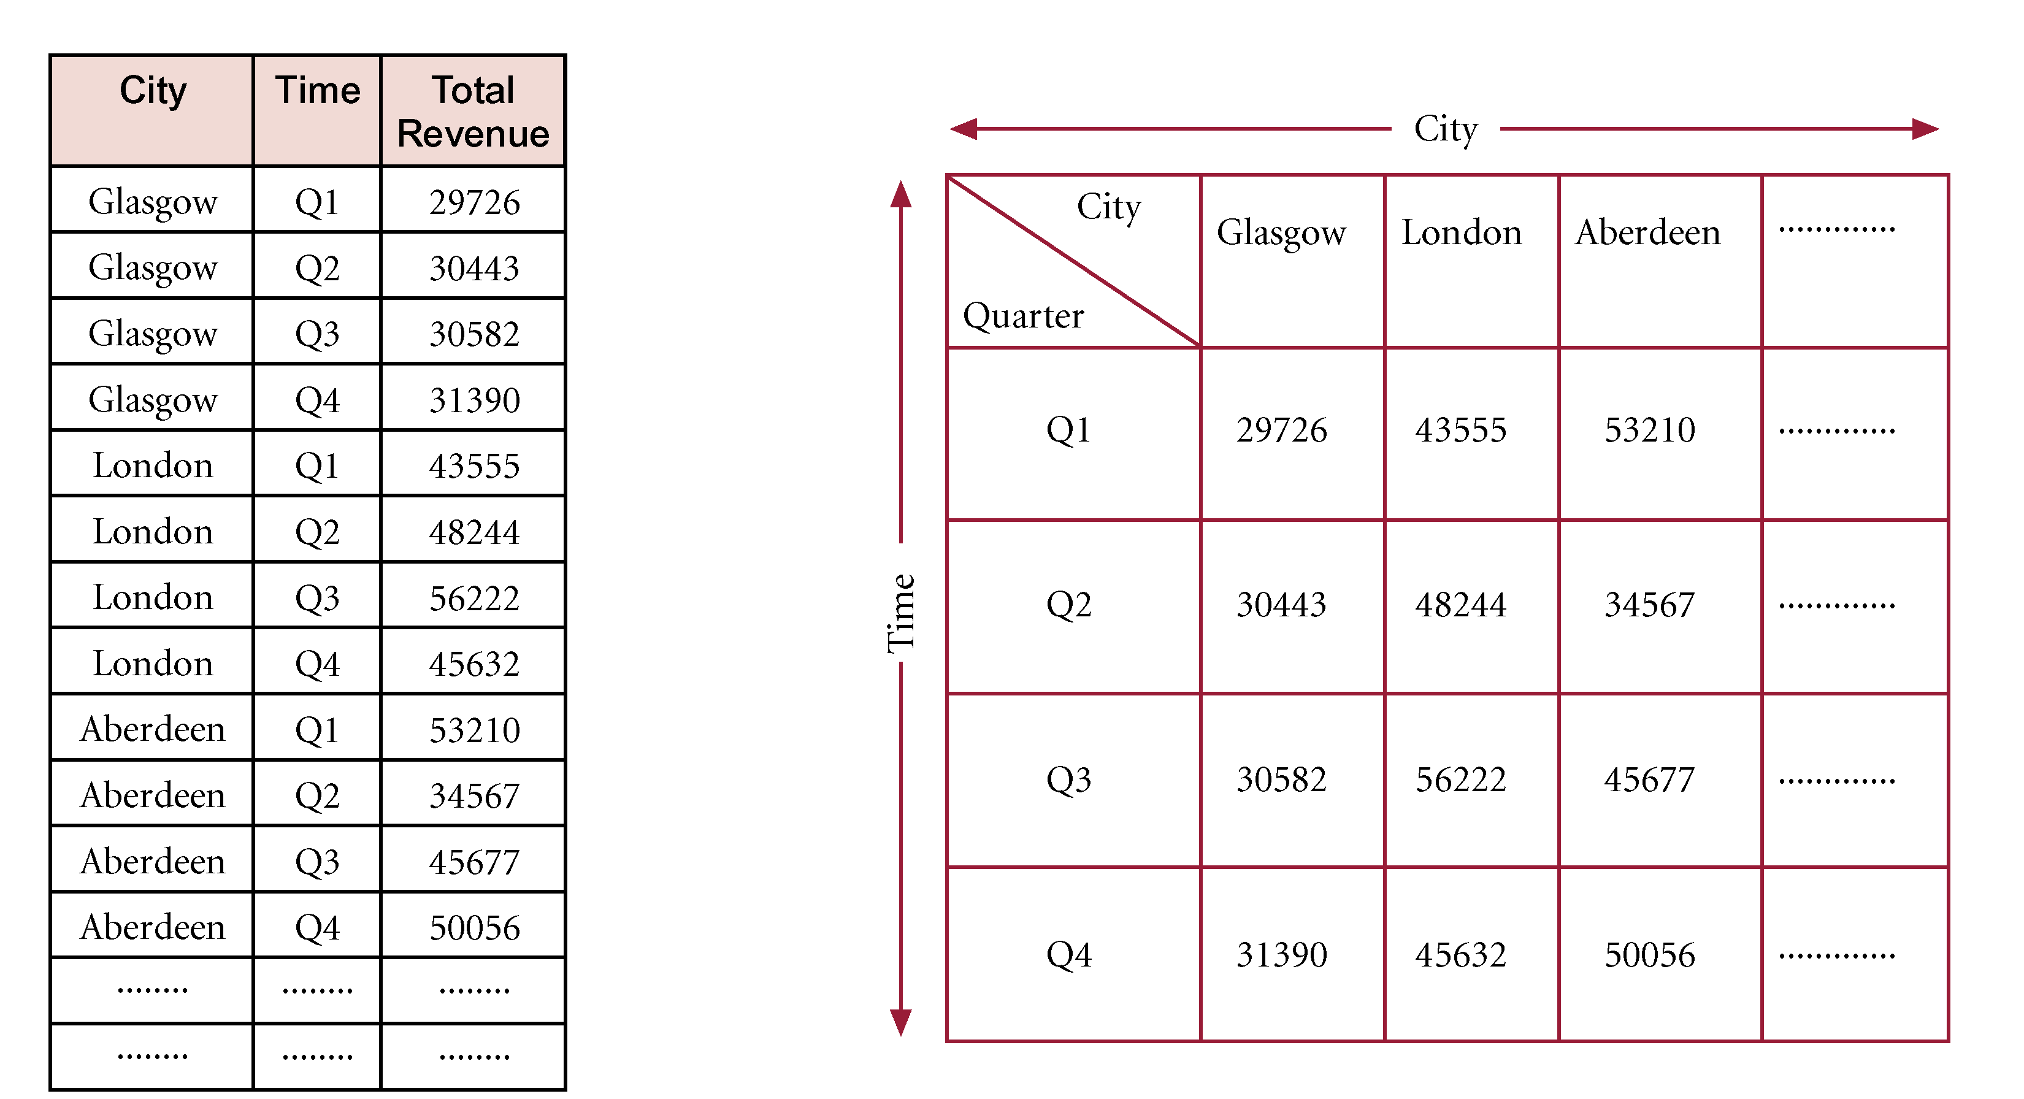
3-Field Table vs. 2-D Matrix
facts!
Case with 2 dimensions

